Slide 1
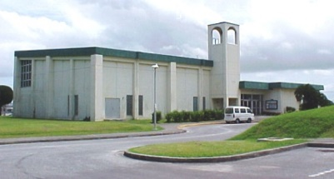
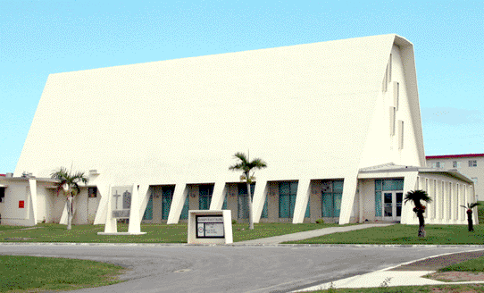
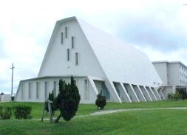

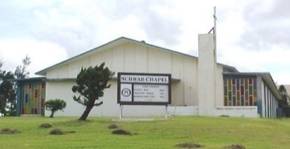

◄ CAMP HANSEN ►
East Chapel (Bldg. 2538) and
West Chapel (Bldg. 2435)
Tel. 623-4619
Current as of October 2022
◄ CAMP COURTNEY ►
Bldg. 4224 Tel. 622-9350/9356
CHAPEL Worship Opportunities
CATHOLIC- (St. Sebastian)
Sunday Mass: 0800
Sunday CCD: 0915
Sunday Youth Group: 1630
Daily Mass, (Tues-Fri): 0730 & 1145
Women's Bible Study, (Wednesday): 1000
Additional Mass service:
(Every 1st & 3rd Friday)
Saturday Mass: 1600
PROTESTANT CHRISTIAN
(Christian Churches)
Sunday Service: 1100 */**
Women’s Bible Study, (Tuesday): 0930*
Wednesday Potluck & Fellowship: 1800*/**
Adult Bible Study, (Wednesday): 1900*/**
Men’s Fellowship, (Every 2nd & 4th Saturday)-
Please call (098-954-9356), for more information
(* Childcare Available; *
* Children’s Ministry Available)
EAST CHAPEL
CATHOLIC
Sunday Mass: 1000
Confessions by appointment before or after mass only-
Please call (623-4619/4226) to make an appointment
WEST CHAPEL
PROTESTANT CHRISTIAN
(Assemblies of God)
Sunday Morning Devotional: 1000
Sunday Service: 1100
Sunday Lunch Fellowship @ Camp Hansen Exchange
Food Court: 1215
Wednesday Fellowship: 1830
Wednesday Bible Study: 1900
For religious services not noted in this brochure, please contact your unit chaplain or visit: https://www.mcbbutler.marines.mil/Base-Information/Chapels/
◄ CAMP SCHWAB ►
Bldg. 3662 Tel. 625-2644
CATHOLIC
Sunday Mass: 1200
Confessions by appointment before/after mass only
(622-9360)
PROTESTANT CHRISTIAN
Sunday Service: 0800
Monday Bible Study: 1900
CHURCH OF JESUS CHRIST OF LATTER DAY SAINTS
Sacrament Service, (Sunday): 1400
For more information please call: (07037918915)
Marine Corps Base
Camp Smedley D. Butler
OKINAWA, JAPAN

Slide 2
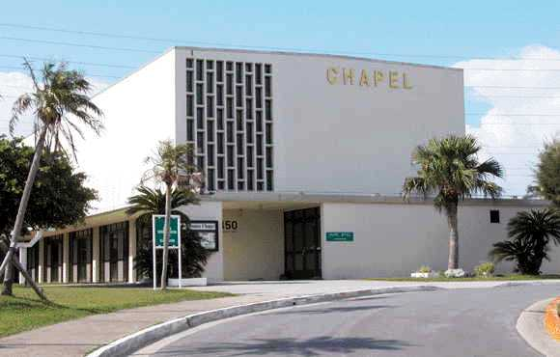
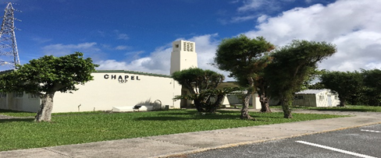
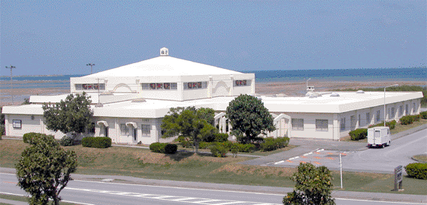
◄ CAMP FOSTER ►
Bldg. 450 Tel. 645-7486
◄ MCAS FUTENMA ►
Bldg.. 102 Tel. 636-6612
◄ CAMP KINSER ►
Bldg. 1092 Tel. 637-1148
ANGLICAN – (Annunciation)
Sunday Holy Eucharist: 0800
CATHOLIC- (St. Francis Xavier)
Sunday Mass: 1000
Daily Mass, (Monday-Friday): 1145
Adoration and Confession, (Tuesday): 1800
Vigil Mass Confessions, (Saturday)
1600-1645
Vigil Mass Service, (Saturday)- 1700
GOSPEL- (United Methodist)
Sunday Service: 1130
*Children's Church
available during service*
Women Bible Study, (Every 2nd Tuesday)
1800
Wednesday Prayer/Bible Study: 1800
Men Bible Study (Every 1st Saturday): 0900
EASTERN ORTHODOX-
(St. Nicholas’ Chapel)
Sunday Orthodox Service: 0800
Sunday Divine Liturgy: 0900
CATHOLIC
Sunday Mass: 1200
PROTESTANT CHRISTIAN
(Presbyterian Church in America - PCA)
Sunday Service: 1000
**Children's Ministry available for grades K-5**
Childcare available for younger children
Monday Evening Bible Study
(Every 1st, 3rd, and 5th Monday of the month)
1800
Please Contact 1stSgt Justin Park for more information: justin.e.park@usmc.mil
Wednesday Dinner and Bible Study:
1800-1945
Join us at the chapel every Wednesday beginning
Oct 5, 2022
Elementary Kids Group
Youth/Teens Group
Young Adult Group
Women’s Group
Men’s Group
CATHOLIC
Sunday Mass: 0800
(Latin-192 Missal)
PROTESTANT CHRISTIAN
Sunday Service,
(Non-Denominational): 1200

